Slide 1
RoboCat- Milestone 1
ALEX VILD, QUINTIN FETTES, ZACH TAYLOR, KURTIS DAVIS, SEATTLE RUZEK, LUKE SHAYS

Slide 2
System Architecture
RoboApp is written using AndroidSDK
The code within the project is written in Java and Matlab. We will mainly be using the Java code.
The app is deployed to the phone, then the phone, with the app running is connected via usb to the cat and mounted on the cat to serve as its “head.”
Notes:
Present

Slide 3
Release Process
From beginning to end:
A developer will clone a branch of the repo
Make improvements to the functionality of the cat
Test branch code on the RoboCat
Merge branch with master upon successful test
Upon completion of these steps, we’ll have a working app which can be deployed to android apps via Android Studio
Notes:
Present

Slide 4

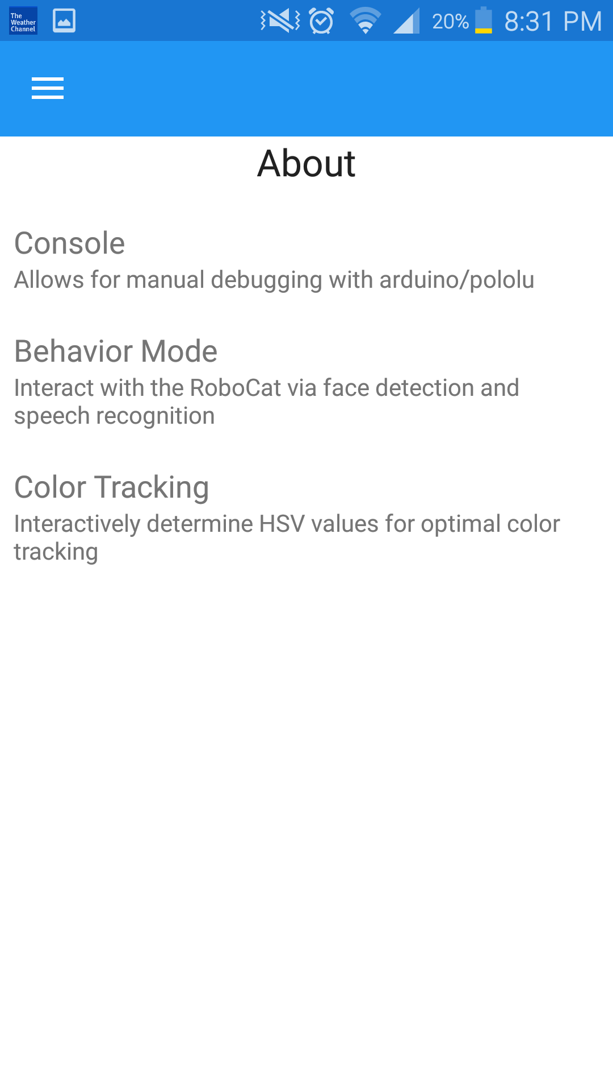
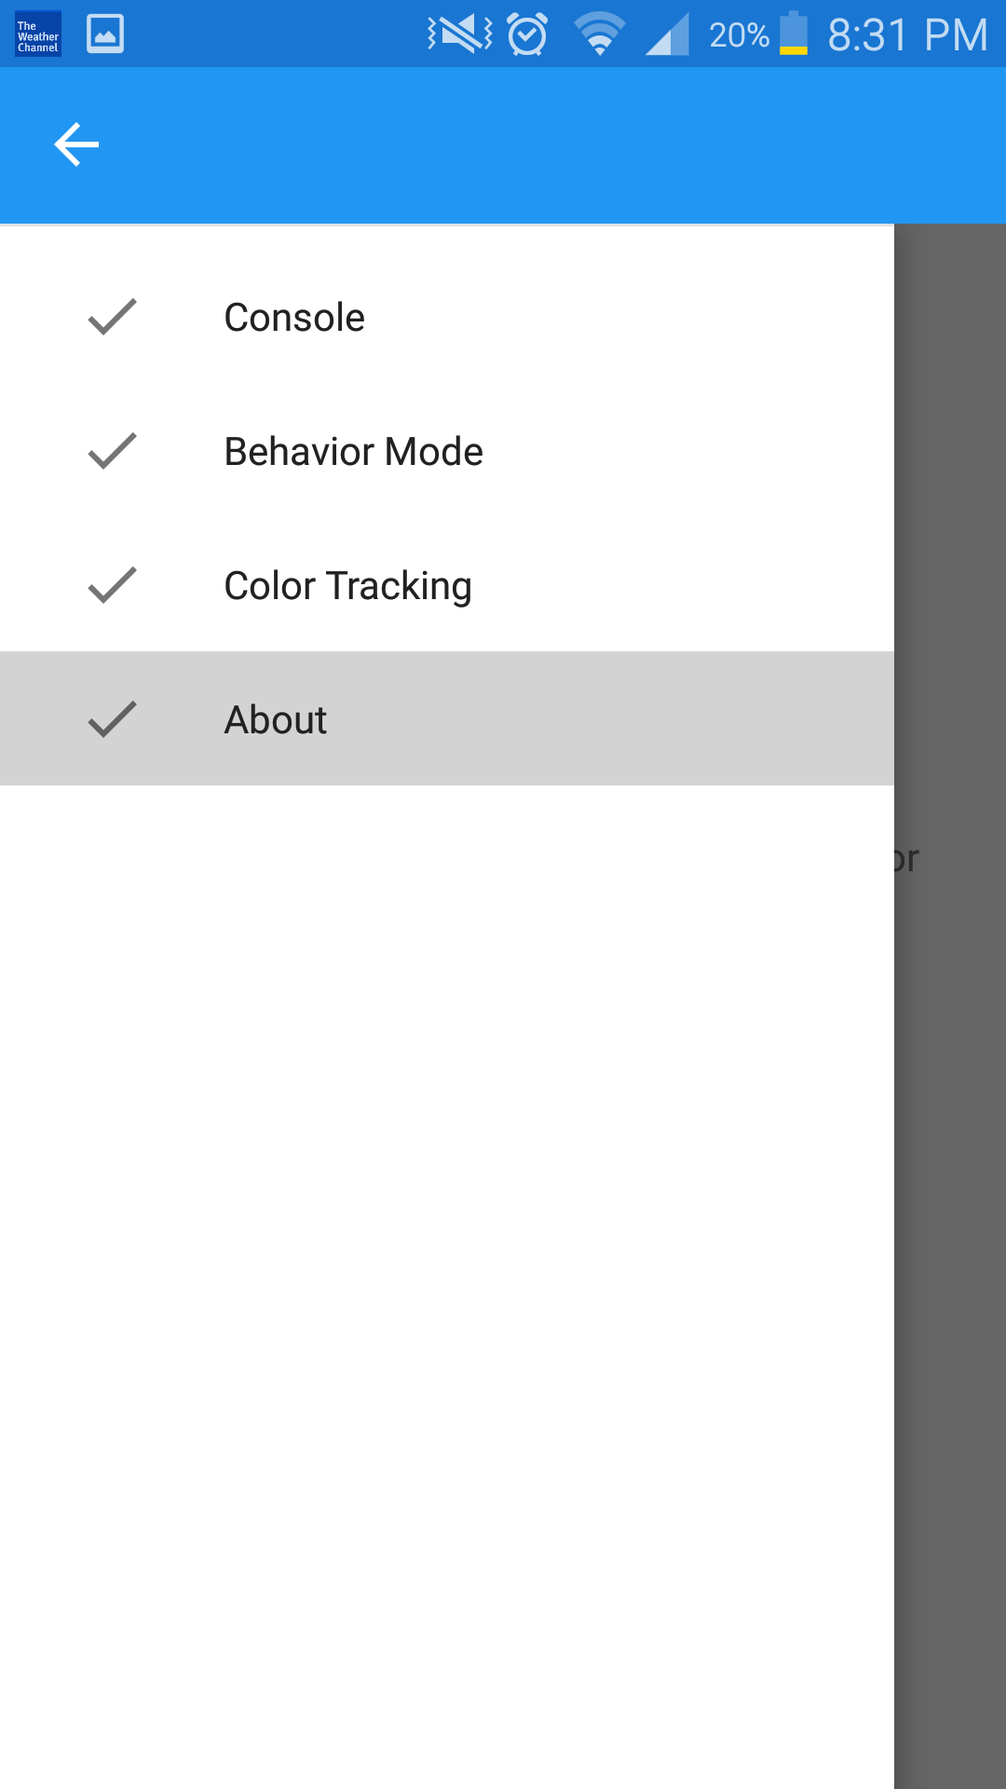
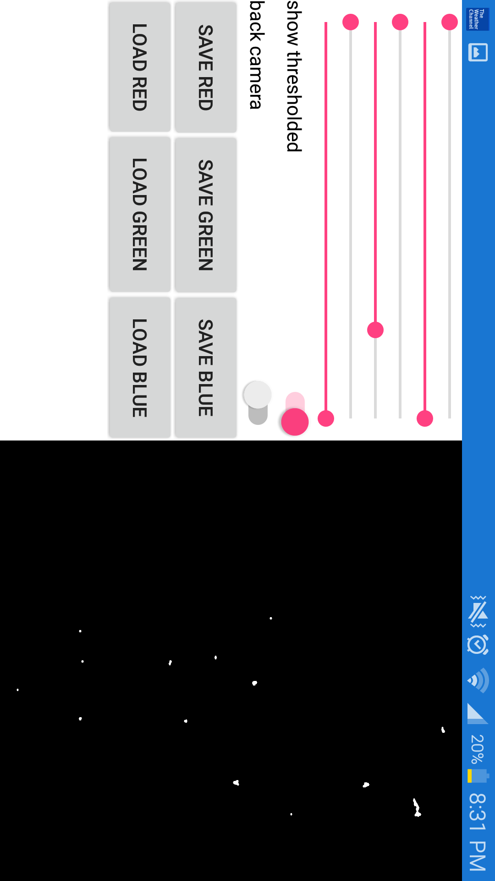
Build 1
Notes:
Don’t present - show late

Slide 5
Original Milestones
Our team was given 3 major goals for improvements to the RoboCat:
Active Speech Recognition
Facial Recognition and Tracking
Environmental Mapping
Initially, our plan was to split into 3 groups of 2 so that we could address these project requirements, with each team of 2 having sub-milestones at each group milestone.
Notes:
Present

Slide 6
Original Milestone 1
Speech Recognition Team
Get familiar with the Android API for speech recognition and the current state of the voice recognition in the app.
Instead of pressing a button to have the cat listen, implement a key phrase that causes the cat to begin listening to phrases; this is similar to Google Now
Facial Recognition Team
Improve the overall accuracy of facial recognition in the cat; a member of the previous team expressed that this feature never worked correctly
Environmental Mapping Team
Decide on a new hardware component to add to the RoboCat to assist in Environmental mapping
Decide a method for communication between both an Arduino Board and the servos controller
Add battery indicator for the app using a creative GUI
Notes:
Present

Slide 7
Original Milestone 2
Speech Recognition Team
Add at least one additional command to the cat’s library of valid commands.
Begin implementing technology to detect emotion and loud, surprising noises.
Facial Recognition Team
Upon detecting a face, the cat will more accurately be able to move its head to center the face in its field of view; in other words, the cat will look at a face it recognizes
Environmental Mapping Team
Establish Communication between the Arduino board, the new hardware, the servos controller, and the phone.
Notes:
Present

Slide 8
Original Milestone 3
Speech Recognition Team
Refine emotion detection based upon the volume/tone of commands
Facial Recognition Team
Support for detecting multiple faces will be added
When detecting multiple faces, the cat will periodically shift attention between these faces; it will move its head to look at all of the faces it sees
The cat will be able to search for and track objects of any user specified color in the environment
Environmental Mapping team
The cat will begin mapping the room
Be able to output the map that he has made of its surroundings
Notes:
Present

Slide 9
Original Milestone 4
Speech Recognition Team
Fully implement Emotion detection via sound/tone of voice
Facial Recognition Team
Basic emotion detection based upon the facial expression in a detected face will be implemented; at the least, the cat will recognize happiness and anger
Environmental Mapping Team
The cat will be able to accurately map its surroundings in an unknown environment. The cat can’t currently walk, so the testing of this will be limited.
Log accelerometer data
Notes:
Present

Slide 10
Early Issues
The app we received wouldn’t even compile!
Time had to be spent organizing the code and debugging it to simply compile and run on a phone
Lack of documentation on the current functionality of the cat
The software components required for Android Studio and the phone to run the app were unknown
Both the speech recognition team and the facial recognition team had planned to build on existing functionalities; we soon found these weren’t functioning correctly leading us to spend time to document the current state of RoboApp.
Notes:
Present

Slide 11
Early Issues
The cat lacks much of the functionality it was claimed to have
Speech recognition is inaccurate; it does not meet an industry standard
Color tracking does not work correctly
Several bugs could be the source of this
There’s no way to access the menu options without voice commands (voice commands don’t work well sometimes)
We’re unsure if the cat simply not hearing commands, or if it’s not mapping these commands to the intended functions correctly
No commands are activating the servos motors of the cat
Due to these unexpected setbacks, we spent the majority of our time exploring what should have already worked and debugging inherited code.
Notes:
Present

Slide 12
New Milestone 1
Group
Debug app to the point that it will compile and run on android devices
Perform a test of the current functions of the Robocat
Document and Organize Git repository
Notes:
Present

Slide 13
New Milestone 1
Speech Recognition Team
Document and test the accepted commands for the cat
Facial Recognition Team
Test the color tracking functionality; evaluate issues with this functionality
Environmental mapping team
Decided on a new hardware component to add to the RoboCat to assist in Environmental mapping - ultrasonic sensor.
Notes:
Present

Slide 14
New Milestone 2
Speech Recognition Team
Overall improved accuracy of speech recognition
Continuous listening, prompted by a keyword for commands
Facial Recognition Team
Recognize a face or faces in the environment
Recognize a user specified color in the environment
Environmental Mapping Team
Establish Communication between the Arduino board, the new hardware, the servos controller, and the phone.
Add a battery indicator using the GUI of RoboApp
Decide a method for communication between both an Arduino Board and the servos controller (whether it can be parallel or communication between servos and phone has to run through the Arduino Board
Determine how accelerometer data is logged.
Notes:
Present

Slide 15
New Milestone 3
Speech Recognition Team
Accurate recognition of all existing commands; additional command will be added
Begin implementing emotion detection based upon volume/tone of voice
Facial Recognition Team
The cat will be able to move its head to center a recognized face in its field of view
the head to center on will periodically be randomly chosen from all recognized faces
The cat will be able to move its head to center a recognized color in its field of view
Environmental Mapping team
The cat will begin mapping the room based on his distance from surrounding objects
Determine how to output the map that he has made observed.
Notes:
Present

Slide 16
New Milestone 4
Speech Recognition Team
Fully implement Emotion detection via sound/tone of voice
Facial Recognition Team
Basic emotion detection based upon the facial expression in a detected face will be implemented; at the least, the cat will recognize happiness and anger
Environmental Mapping Team
The cat will be able to accurately map its surroundings in an unknown environment. The cat can’t currently walk, so the testing of this will be limited.
Log accelerometer data.
Notes:
Present

Slide 17
Individual Contributions and Responsibilities: Milestone 1
Speech Recognition Team:
Alex:
Debug App so that it compiled
Familiarized self with code
Added additional voice command
Added documentation of vocal commands
Developed sample applications in android studio to get familiar with process and language
Kurtis
Debug App so that it compiled
Notes:
Present

Slide 18
Individual Contributions and Responsibilities: Milestone 1
Facial Recognition Team:
Quintin
Debug App so that it compiled
Test the color Tracking functionality; evaluate issues/bugs
Meeting Manager: Collect info on progress of each member, direct the setting of goals for each member
Reorganize Git repository. Delete junk files uploaded by last team, organize our app and documents, add documentation about the structure of the git repository (where to put code, meeting minutes, documentation, etc…)
Evaluate OpenCV code for facial recognition; I chose to move forward using the Android API because the openCV code does not work, so starting from scratch with an easier-to-use library will be much more efficient.
Notes:
Present

Slide 19
Individual Contributions and Responsibilities: Milestone 1
Facial Recognition Team:
Lukas
Debug App so that it compiled
Test the color Tracking functionality; evaluate issues/bugs
Determine whether or not it would be viable to move existing openCV color tracking to an android-based API
Notes:
Present

Slide 20
Individual Contributions and Responsibilities: Milestone 1
Environmental Mapping Team:
Seattle:
Debug App so that it compiled
Research potential hardware devices to add for environment mapping
Determine method of communication between the Arduino board and the Servo controllers and the phone.
Learn the purpose of the hardware components and how they interconnect in order to determine the best method of communication between them (Miguel isn’t sure of the communication right now).
Zach
Debug App so that it compiled
Research the pros and cons of potential hardware devices to add to Robocat for environmental mapping
Decide which hardware best suits the project based on previous research
Notes:
Present

Slide 21
Individual Responsibilities: Milestone 2
Speech Recognition Team:
Alex:
Add a way to access the menu via touch commands instead of only speech command
improve the accuracy of voice recognition
debug mapping of voice commands to actions
Kurtis
Add developer option to display the text version of speech commands, so that the user can see what the cat heard
implement continuous voice recognition
debug mapping of voice command to actions
Notes:
Present

Slide 22
Individual Responsibilities: Milestone 2
Facial Recognition Team:
Quintin
Implement a facial recognition system. Cat will be able to recognize faces in its field of view
no head motion in this step
Lukas
Implement a color recognition system. Cat will be able to identify a user specified color in its field of view. No head motion in this step
Notes:
Present

Slide 23
Individual Responsibilities: Milestone 2
Environmental Mapping Team
Seattle
Establish Communication between the Arduino board, the new hardware, the servos controller, and the phone.
Log accelerometer data
Devise method of communication between RoboApp and the Arduino
Zach
Establish communication between RoboApp and the Arduino
Add a battery indicator using the GUI of RoboApp
Notes:
Present

Slide 24
Our new MVP
Our MVP did not change! Our current goals still go far beyond the MVP
Requirements
Continuous Voice Recognition for existing commands
Color Tracking ability
Face Tracking ability
Environmental mapping: functioning sensor and mapping. The cat can’t walk, so functionality will be slightly limited
Log accelerometer data
Add Battery indicator
We will deliver an application that is far more manageable and sustainable than what was given to us and former groups before us, with clean and descriptive documentation and code.
We will meet and exceed these goals according to our schedule!
Notes:
Present

Slide 25
Meetings
See submitted zip file

Slide 26
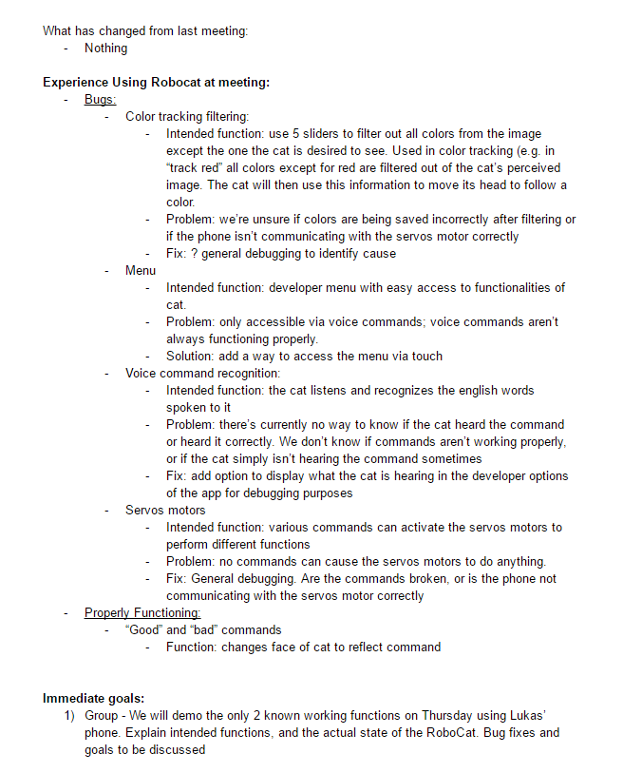
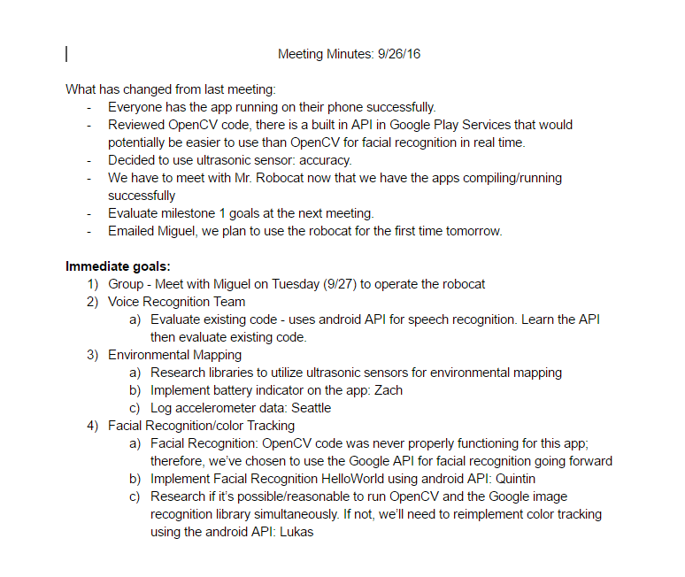
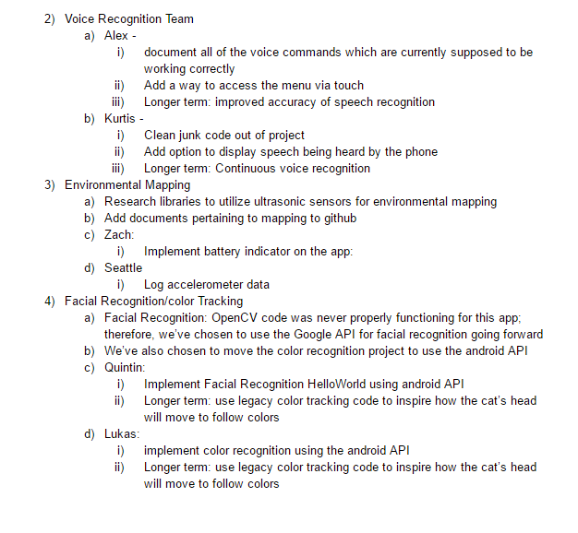
Meetings

Slide 27
Git Log
See attached submitted commit documents

Slide 28
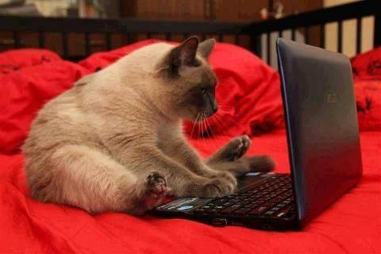
RoboCat Project
Notes:
Introduce ourselves

Slide 29
The app
Notes:
Kurtis
explain purpose of GUI shows faces
what microphone does
explain the menu is only for development purposes

Slide 30
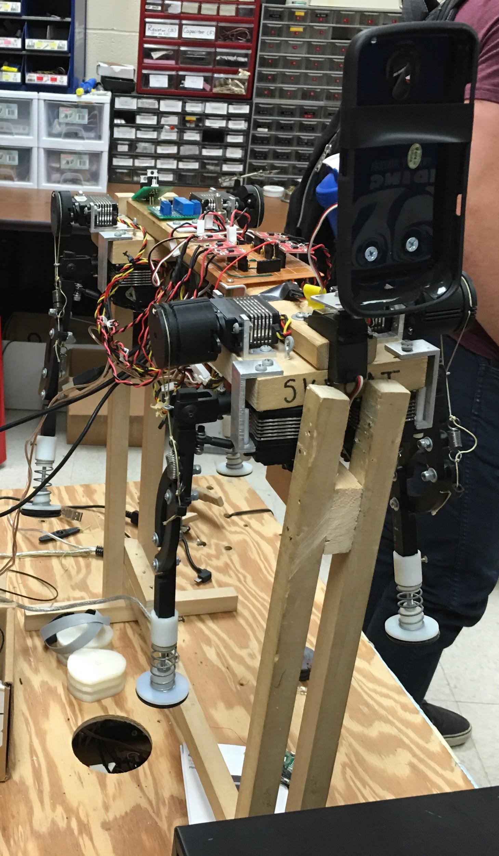
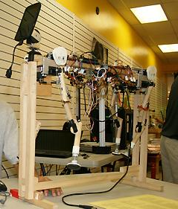
The RoboCat
Notes:
Explain the connection of the phone to the cat
Explain the connection of the phone to the motors
Zach

Slide 31
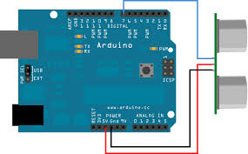
The new environmental Mapping Hardware
Ultrasonic sensor
Notes:
Explain connection of phone to arduino to servos
explain ultrasonic sensor
explain how info can be used to map room
Seattle

Slide 32
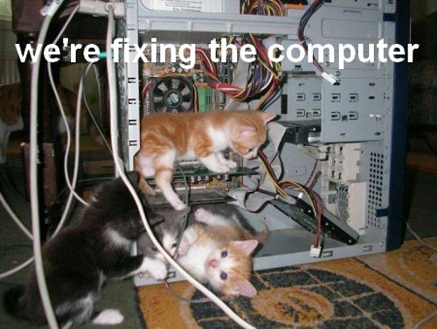
The Issues
Didn’t compile at first
Voice recognition accuracy isn’t great
Phone can’t control servos motors
Color Tracking and Facial recognition are broken
Notes:
Quintin

Slide 33
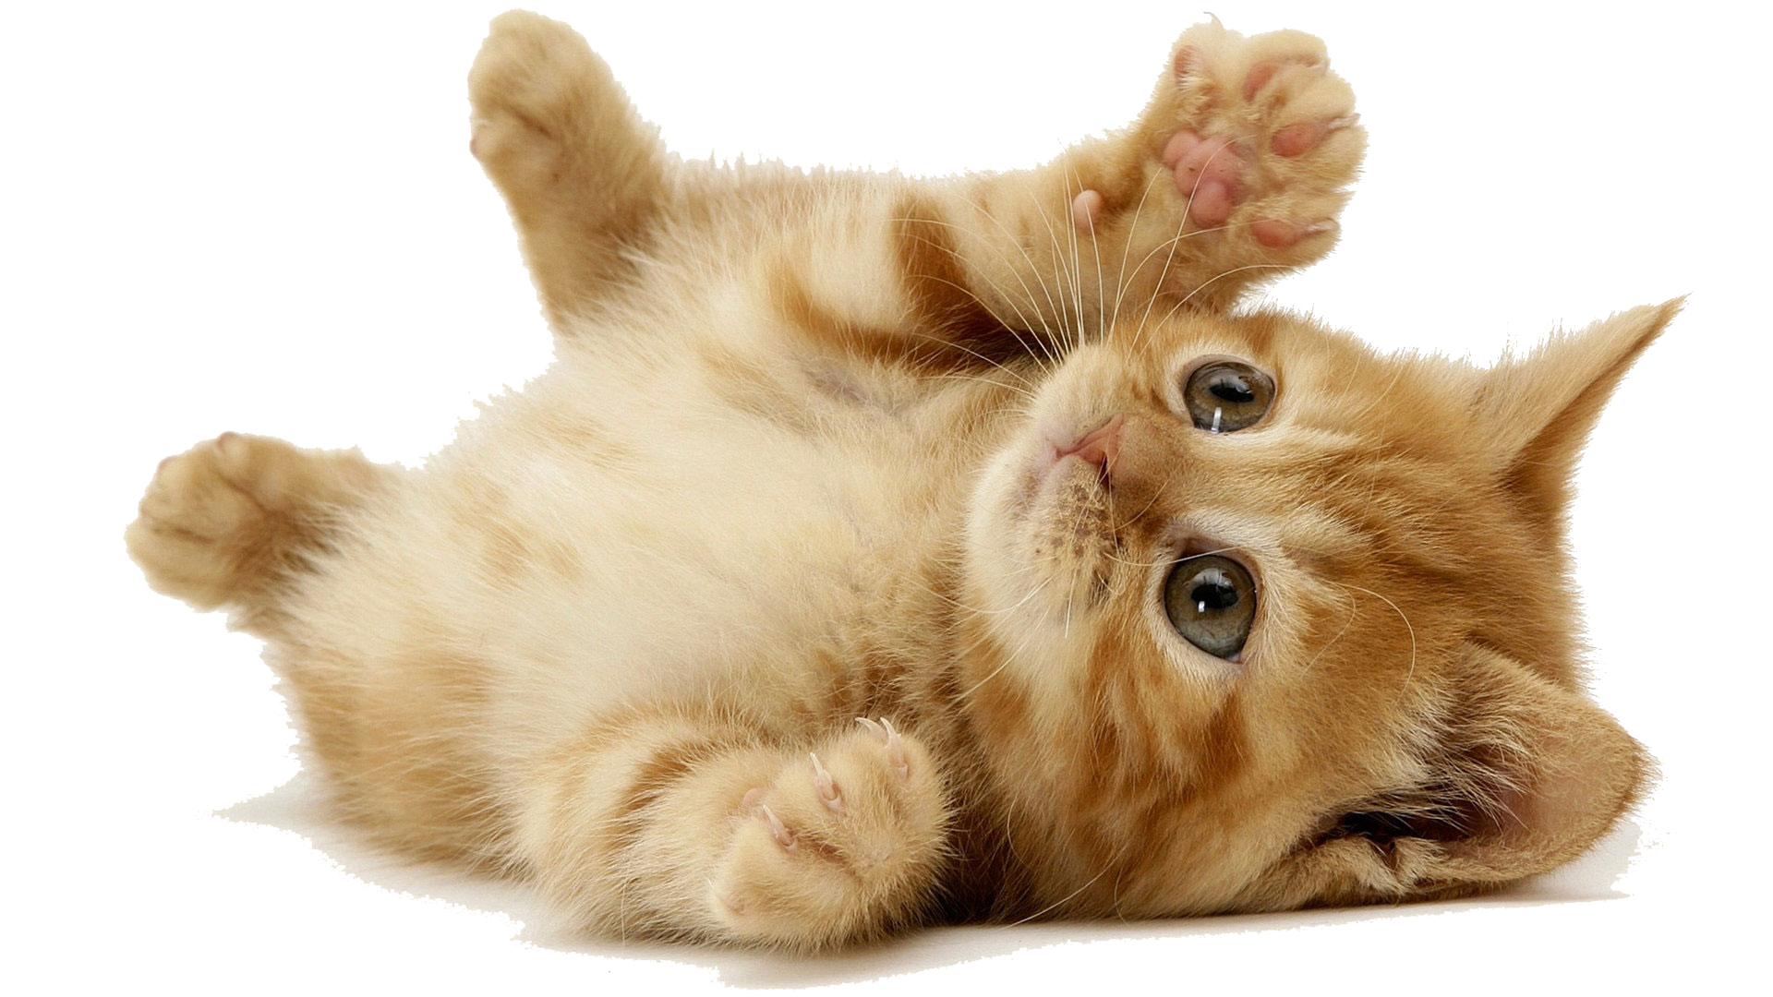
The Strengths
The GUI is in place, and serves its function well
3 voice commands are properly functioning
“Good,” “Bad,” and “Love”
Notes:
Alex

Slide 34
The Demo
Lukas will show working voice commands on his phone
Notes:
Lukas

